Slide 1
Sales Data Analysis and Prediction
Santhosh R
7229 – exl Chennai

Slide 2
Problem Statement (Extreme Gradient Boosting )
There is supermarket company that has several outlets or several store around the world. They want to predict the sales which they can expect.
lot of things that are helpful this prediction.
i.e if we can predict the
sales revenue
what are the brands and what are the products that sells the most and other.
we can tell the company that what are the challenges they may face

Slide 3
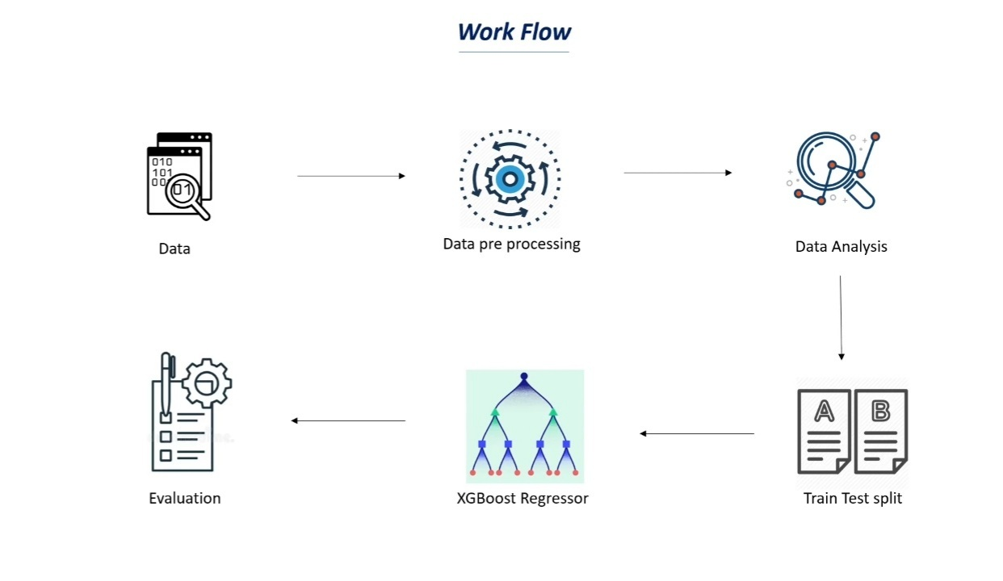
Work Flow

Slide 4


Data Collection and Processing
loading DataFrame (Pandas )
some information about the dataset (info)
Find Null value and replace
Mean
Mode

Slide 5
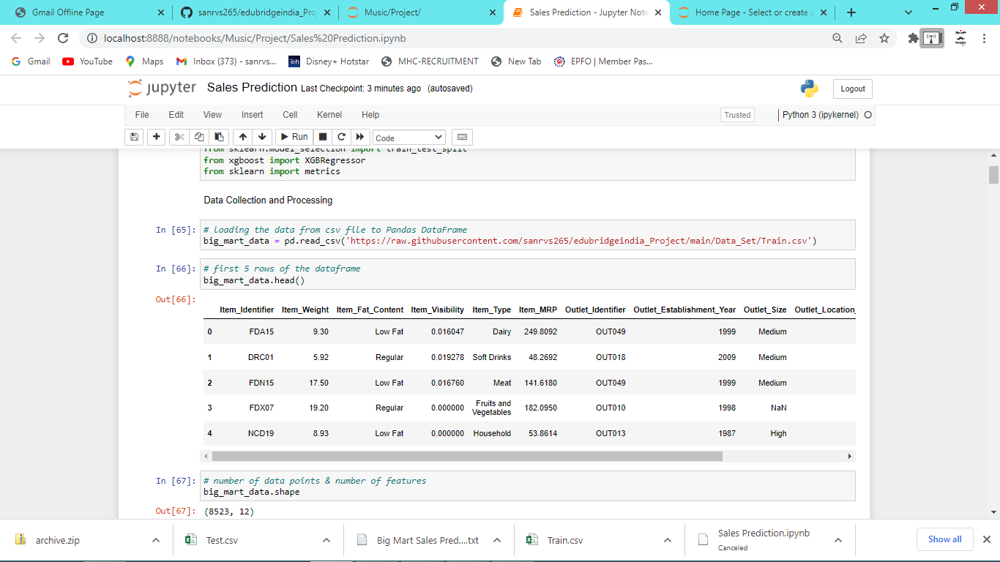
loading Data
Total row 8523
Total column 12

Slide 6
some information of the dataset
<class 'pandas.core.frame.DataFrame'>
RangeIndex: 8523 entries, 0 to 8522
Data columns (total 12 columns):
# Column Non-Null Count Dtype
--- ------ -------------- -----
0 Item_Identifier 8523 non-null object
1 Item_Weight 7060 non-null float64
2 Item_Fat_Content 8523 non-null object
3 Item_Visibility 8523 non-null float64
4 Item_Type 8523 non-null object
5 Item_MRP 8523 non-null float64
6 Outlet_Identifier 8523 non-null object
7 Outlet_Establishment_Year 8523 non-null int64
8 Outlet_Size 6113 non-null object
9 Outlet_Location_Type 8523 non-null object
10 Outlet_Type 8523 non-null object
11 Item_Outlet_Sales 8523 non-null float64
dtypes: float64(4), int64(1), object(7)
memory usage: 799.2+ KB

Slide 7
Find Null value and replace
Null value checking | After Repace null value (Mean,Mode)
Item_Identifier 0 Item_Weight 1463 Item_Fat_Content 0 Item_Visibility 0 Item_Type 0 Item_MRP 0 Outlet_Identifier 0 Outlet_Establishment_Year 0 Outlet_Size 2410 Outlet_Location_Type 0 Outlet_Type 0 Item_Outlet_Sales 0 dtype: int64 | Item_Identifier 0 Item_Weight 0 Item_Fat_Content 0 Item_Visibility 0 Item_Type 0 Item_MRP 0 Outlet_Identifier 0 Outlet_Establishment_Year 0 Outlet_Size 0 Outlet_Location_Type 0 Outlet_Type 0 Item_Outlet_Sales 0 dtype: int64

Slide 8
Data Analysis
Data information
Numerical Features
Weight distribution
Visibility distribution
MRP distribution
Outlet_Sales distribution
Establishment_Year column
Categorical Features
Fat Content column
Type column
Outlet Size column

Slide 9
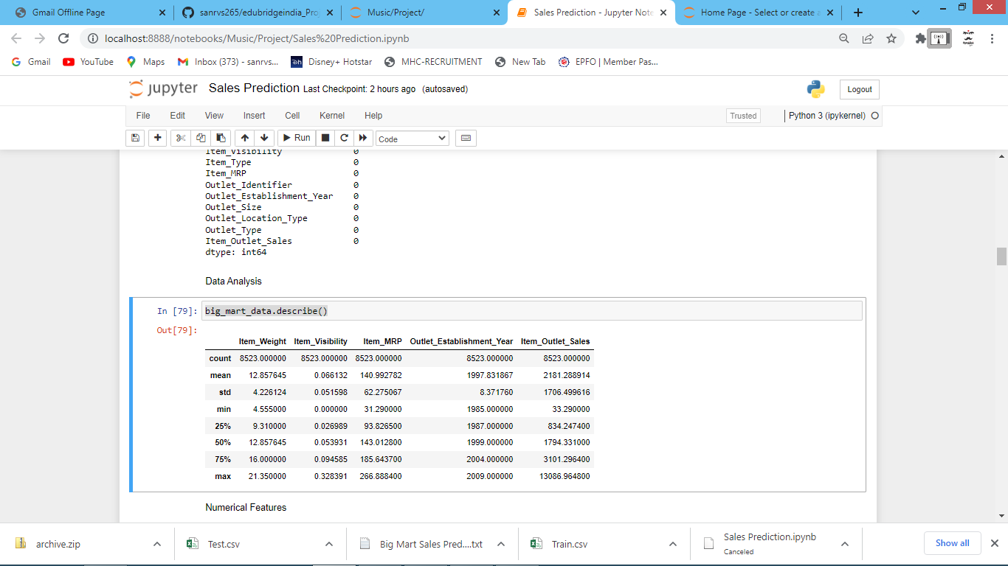
Data information

Slide 10
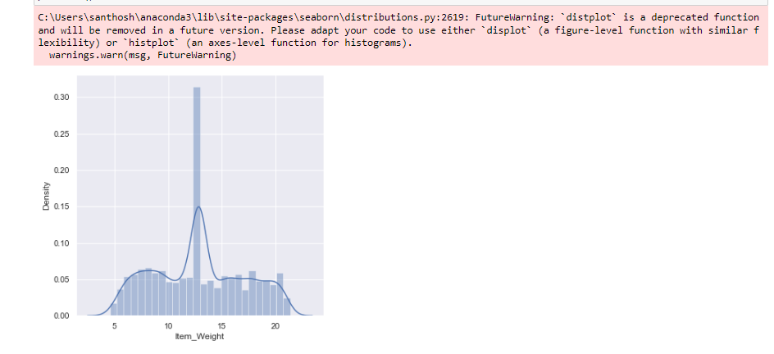
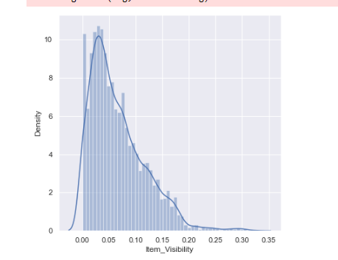
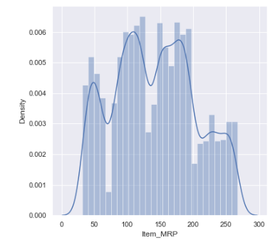
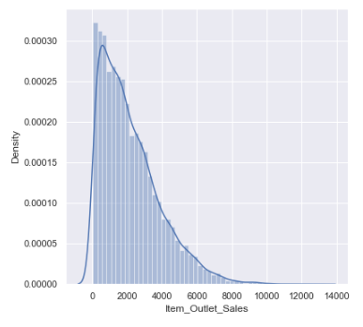
Numerical Features

Slide 11
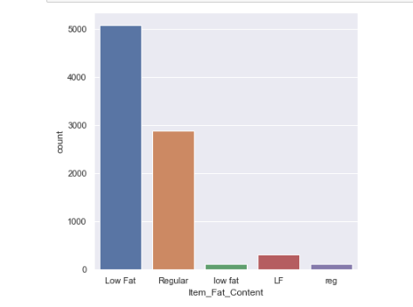
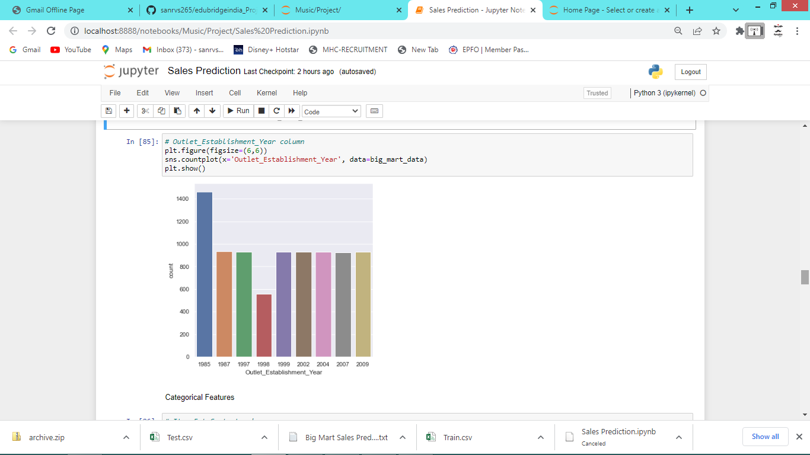
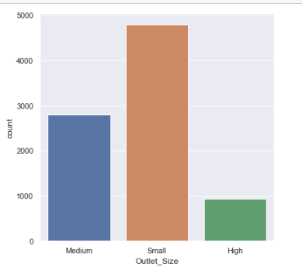
Categorical Features

Slide 12

Data Pre-Processing
Item Fat Columns Content
Low Fat 5089
Regular 2889
LF 316
reg 117
low fat 112
Replace
LF,low fat = Low Fat
After Replace Item Fat Columns Contents
Low Fat 5517
Regular 3006
Label Encoding

Slide 13
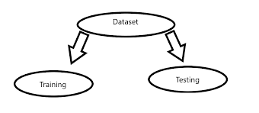
Splitting features and Target
X = Item_Identifier, Item_Weight, Item_Fat_Content, Item_Visibility, Item_Type, Item_MRP, Outlet_Identifier, Outlet_Establishment_Year, Outlet_Size, Outlet_Location_Type, Outlet_Type ( 8523 rows x 11 columns )
Y = Item_Outlet_Sales ( 8523 rows x 1 columns )
X_train, X_test, Y_train, Y_test = train_test_split(X, Y, test_size=0.2, random_state=2)
X.shape, X_train.shape, X_test.shape
(8523, 11) (6818, 11) (1705, 11)
Y.shape, Y_train.shape, Y_test.shape
(8523,) (6818,) (1705,)

Slide 14

XGBoost Regressor
Extreme Gradient Boosting
used for supervised learning problems
XGBoost algorithm ( XGBRegressor )
XGBRegressor.fit(X_train, Y_train)

Slide 15

Evaluation
Prediction on training data
training_data_prediction = regressor.predict(X_train)
R squared Value ( 0.86 )
Prediction on test data
test_data_prediction = regressor.predict(X_test)
R squared Value ( 0.52 )

Slide 16
Thank You

